Slide 1

Exploratory Data Analysis on Mutual Funds

Slide 2
Agenda
What is Mutual Funds?
Objective of the Project
Web Scraping
Information about Collected Data
Exploratory Data Analysis:
Data Cleaning Steps
Data Manipulation Steps
Mutual Fund Types
Expense Ratio and Return Analysis
Analysis Based on Fund Performance
Conclusion (Mutual Fund Portfolio)
Q&A Slide

Slide 3
Quick Introduction About us
Naga Babu K
I completed my graduation In the stream of Civil Engineering, I’m the Self learner, I’m exited to learn new things.
I want start my with career as a data scientist because this is one of the world leading Technology which going to rule the next 10 to 20 years.
Aravinth B
I started my career by pursuing a degree in Mechatronics, a field that has provided me with a strong foundation in Mechanics, Electronics and Computer Control Systems.
Recognizing the pivotal role that data science plays in the realm of robotics and artificial intelligence. I honed my skill in Python programming. My passion led me further to Explore the world of AI and machine learning.
But my curiosity didn't stop there. I also found myself drawn to the intricate landscape of investing and finance. My fascination with understanding how money flows, grows, and shapes economies drove me to explore this field further.

Slide 4
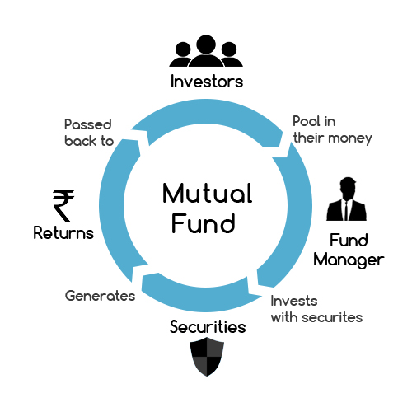
What is Mutual Funds?
Mutual Funds is a trust that collects money from a number of investors who share a common investment objective.
Fund Manager invests the money in equities, bonds, money market instruments and other securities.
These Mutual Fund Trusts are controlled by a Company known as Asset Management Company (AMC)

Slide 5
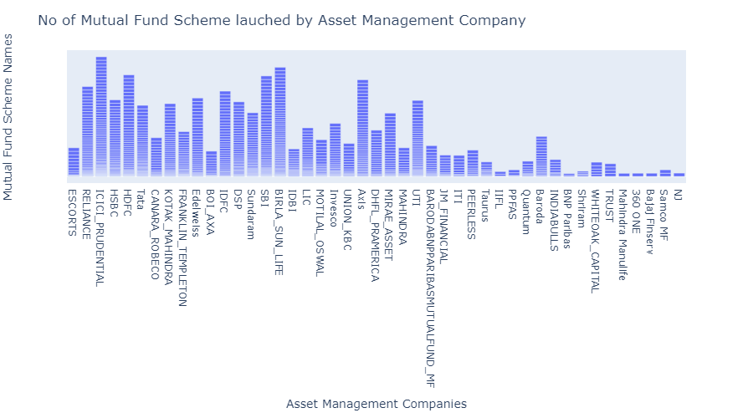
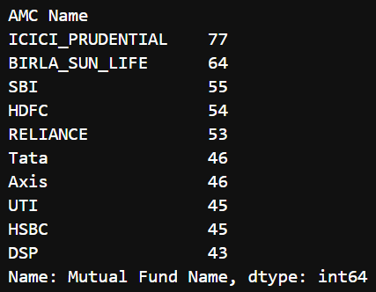
AMC and Mutual Fund Schemes
Total AMC : 45
AUM – Asset Under Management
Top 10 AMC

Slide 6
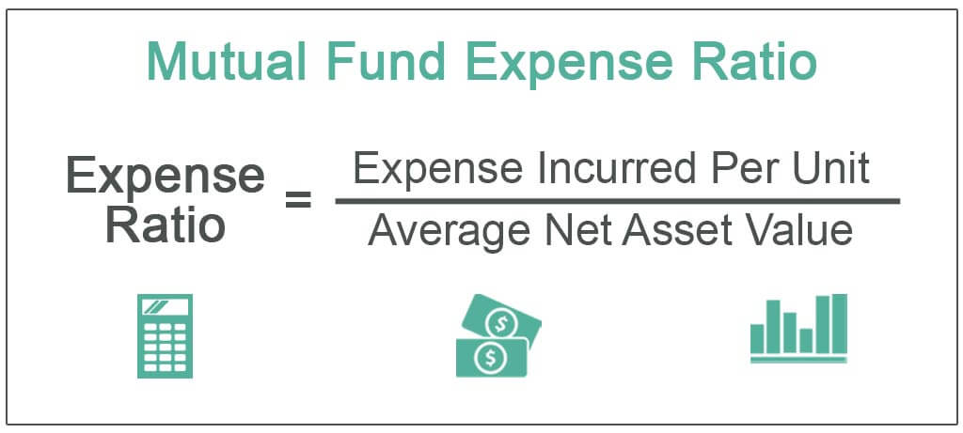
Roles of Fund Manager
Fundamental Analysis
Technical Analysis
Economical Factors
* GDP
* Country Debt
* Purchase Power Priority
* Unemployment Rate
* Trade Deficit
Repo Rate
Inflation and Customer Price Index (CPI)

Slide 7
How these Fund Houses Get Profit
Expense Ratio
Exit Loads

Slide 8

How to choose Mutual Funds
Expense Ratio
Fund Performance
Exit Load
Investment Goal
Risk Factor
Mutual Fund Type or Investment Strategy
AMC Management Analysis
Fund Manager History
Tracking Error

Slide 9
Any Questions about
Mutual Fund?

Slide 10
Objective of our Project
To familiarize you with different types of mutual funds based on their investment objectives, such as equity funds, debt funds, hybrid funds and sector-specific funds.
To Analyse Mutual Funds which have very less Expense Ratio and a larger portion of potential returns is retained.
Designing a Diversified Mutual Fund Portfolio for Optimal Returns and Minimal Expenses

Slide 11
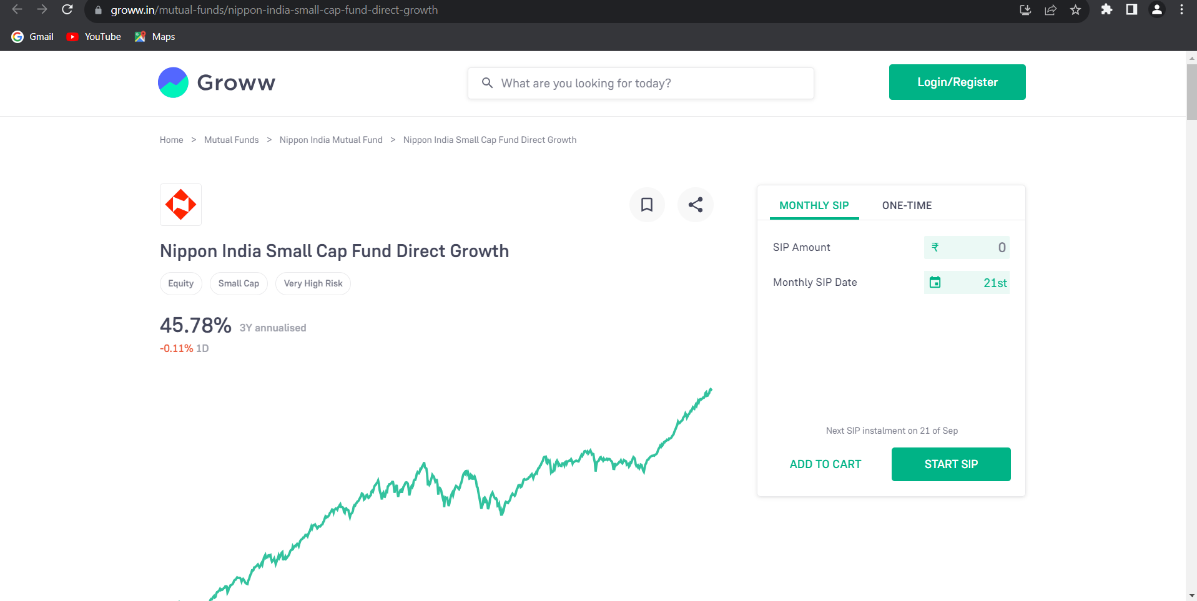
Data Collection
We collect Data From Groww

Slide 12
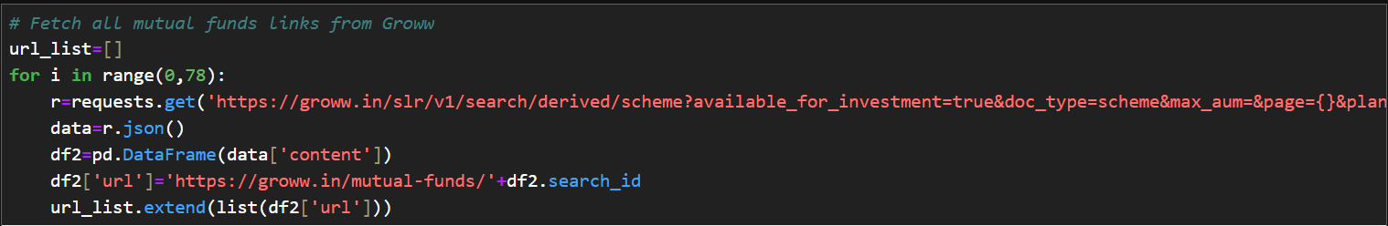
Data Collection Process
First we extract every link of Each Mutual Fund using Groww API call with help of Requests, BS4 and JSON python modules.
After getting URLs of each Mutual Funds request them and get the JSON data through BeautifulSoup and JSON python modules and extract the targeted data from JSON and append it to respective Lists.
After Extract every data, create a Data Frame using list and save Data Frame to CSV file.

Slide 13
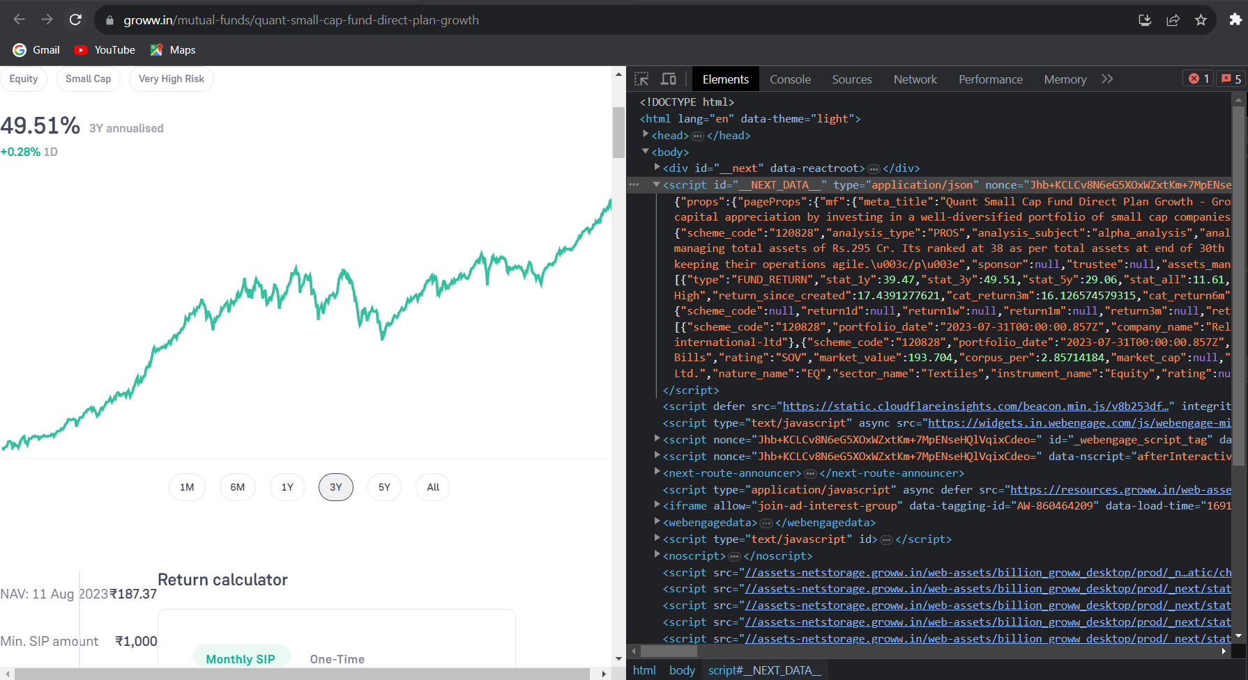
JSON Data

Slide 14
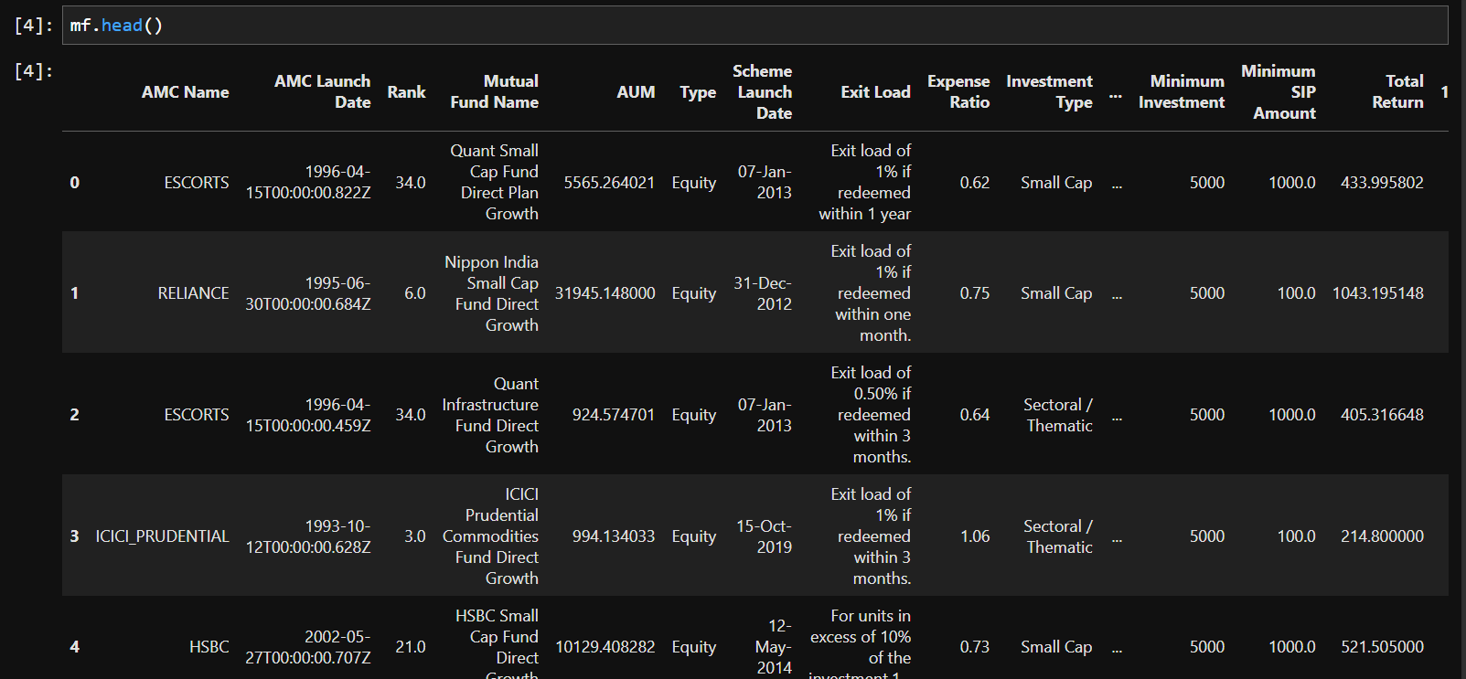
DataFrame Overview

Slide 15
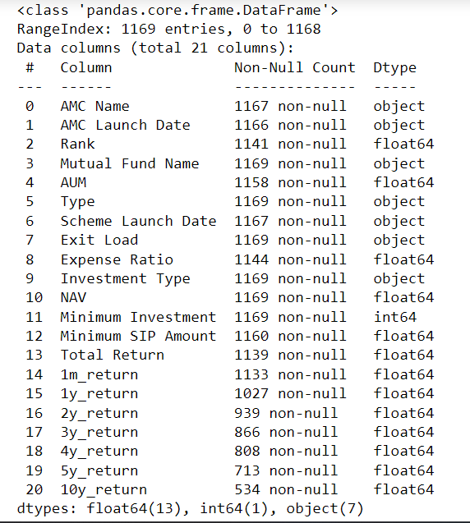
Feature Extracted
Total Columns :- 20
AMC, Fund Type, Expense Ratio, Exit Load and Fund Performance Data we Extracted from Groww

Slide 16
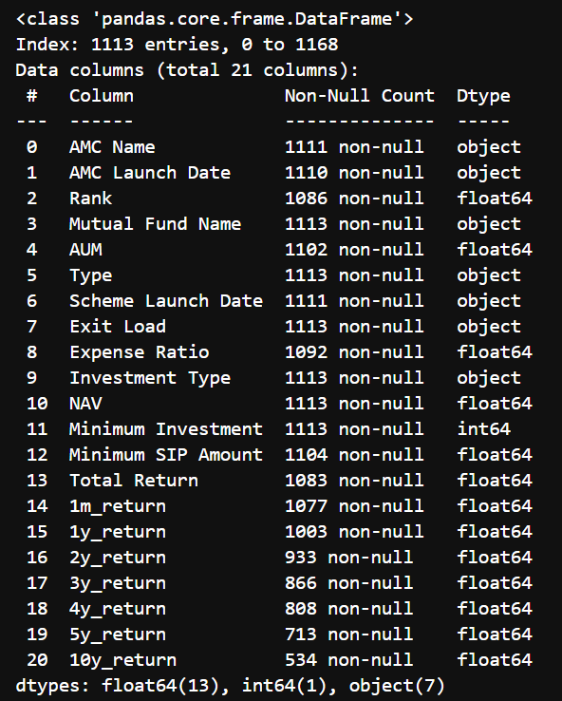
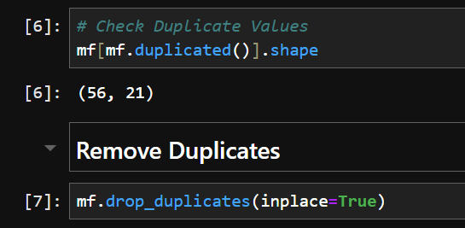
Data Cleaning – Removing Duplicates
Check for Duplicated Data

Slide 17
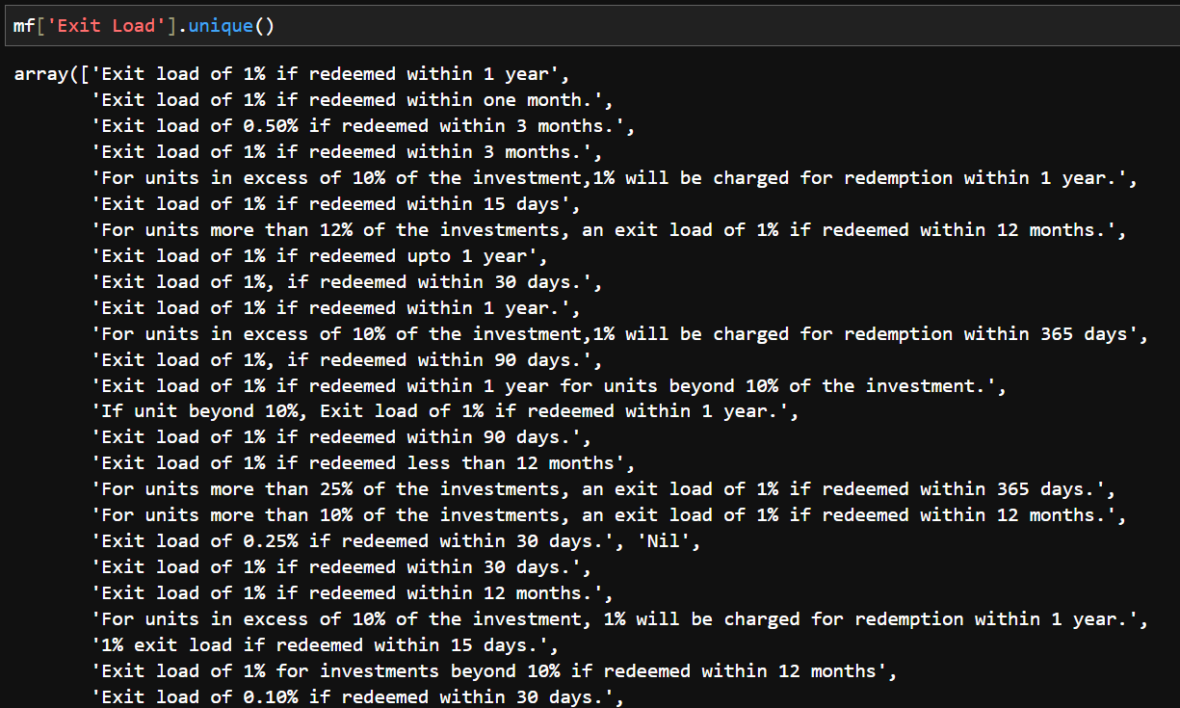
Data Cleaning – Extract Exit load for Text
Take a look of Exit load Column

Slide 18
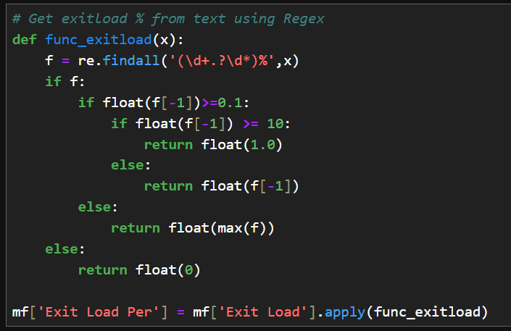
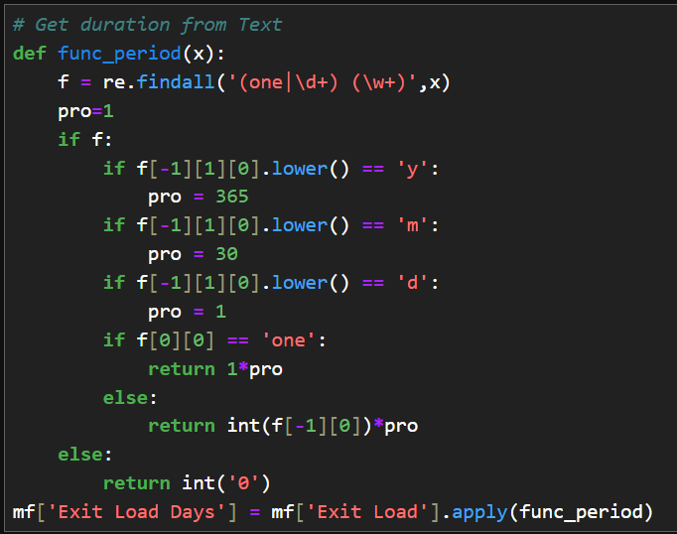
Data Cleaning – Extract Exit load for Text
Function to Extract Exit Load % from Text
Function to Extract Exit Load Period from Text

Slide 19
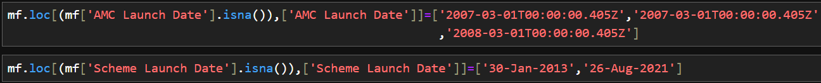
Data Cleaning – Missing Values Treatment
Drop row if Expense Ratio and Total Return both are Null
If Expense Ratio is missing then fill it with mean based on Type of Mutual Fund
If Return is missing then fill it with 0
Fill AMC Name & Missing Date manually

Slide 20
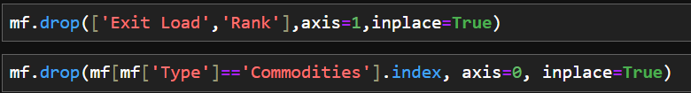
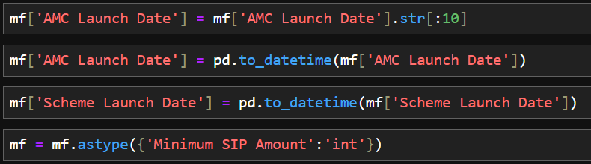
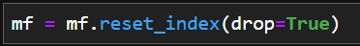
Data Cleaning – Type Conversion
Remove unwanted Columns and Rows
Convert object to Date Time & Integer Data Type
Reset Index

Slide 21
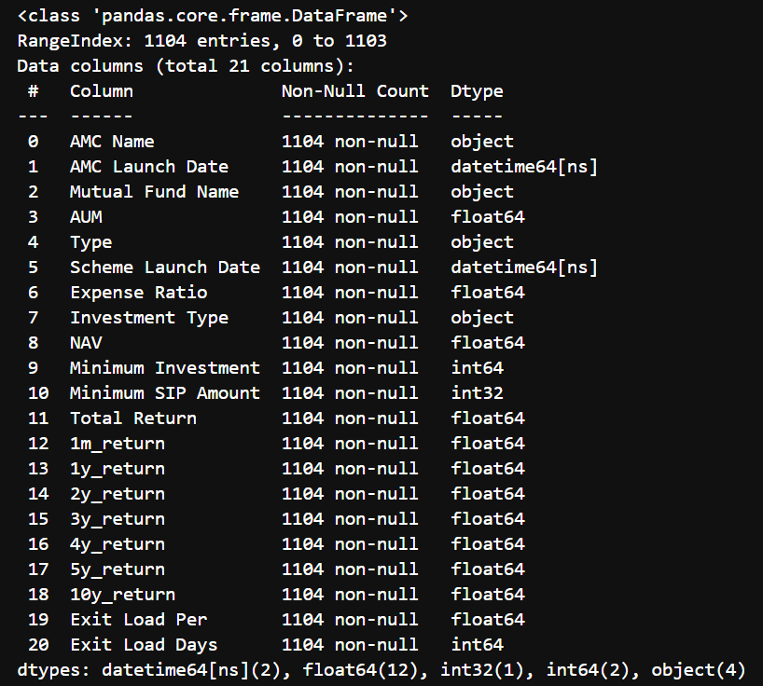
Data After Cleaning

Slide 22
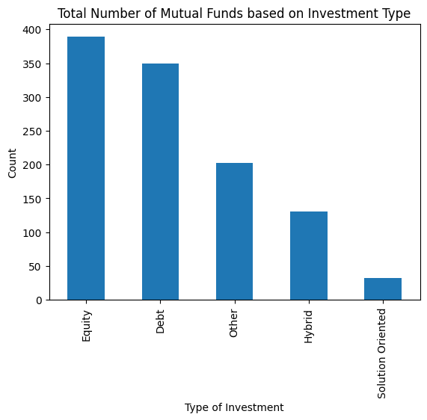
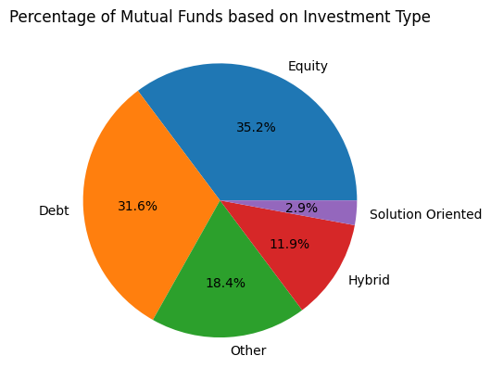
What are the Types of Mutual Funds
Equity Mutual Funds are more in our Data
Follow by Debt Other Hybrid and Solution Oriented

Slide 23
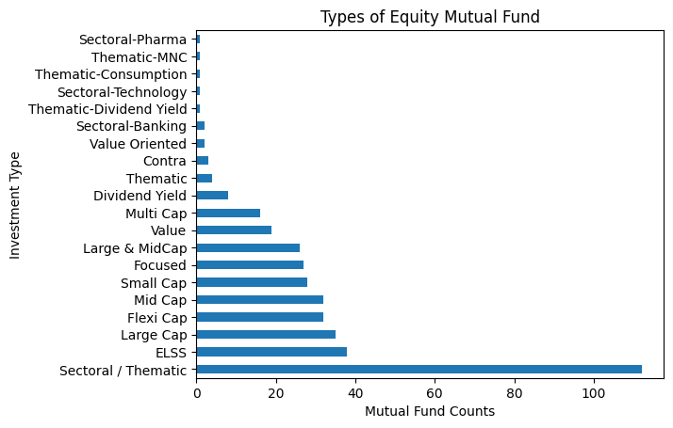
Types of Equity Mutual Funds
Large-cap companies
market cap > Rs 20,000 crore or more.
Mid-cap companies
market cap > Rs 5,000 crore and
market cap < Rs 20,000 crore.
Small-cap companies
market cap < Rs 5,000 crore.

Slide 24
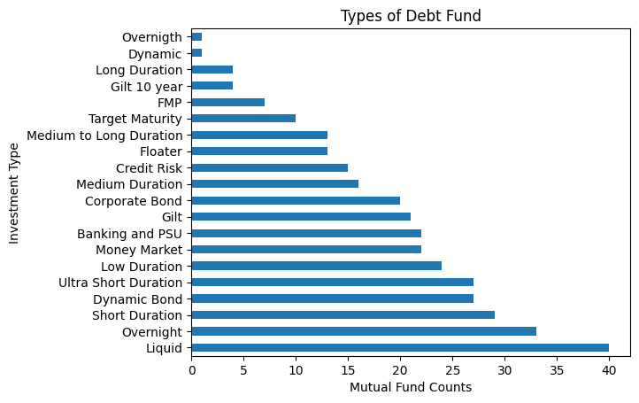
Types of Debt Mutual Funds

Slide 25
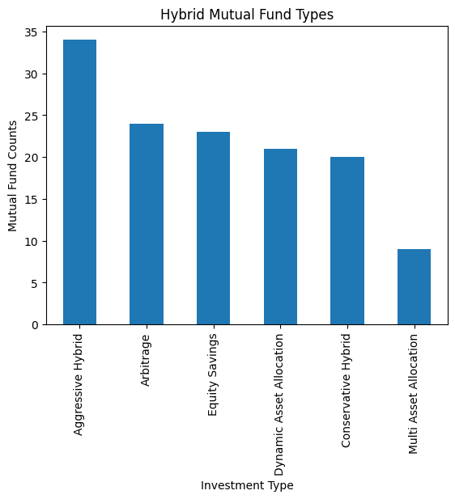
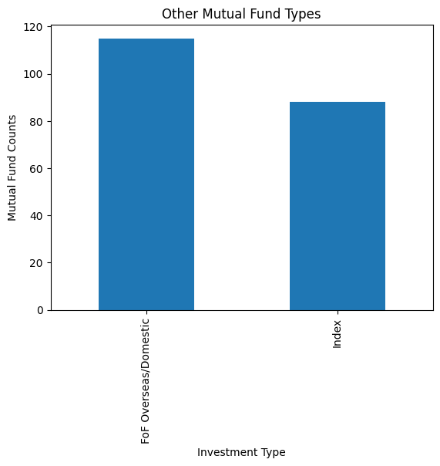
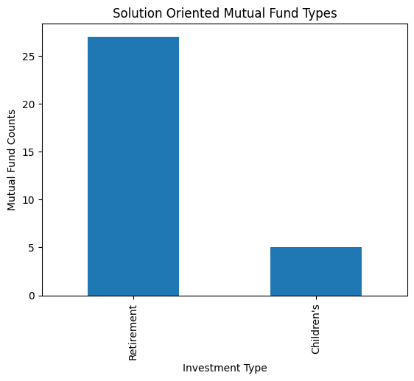
Other Types of Mutual Funds

Slide 26
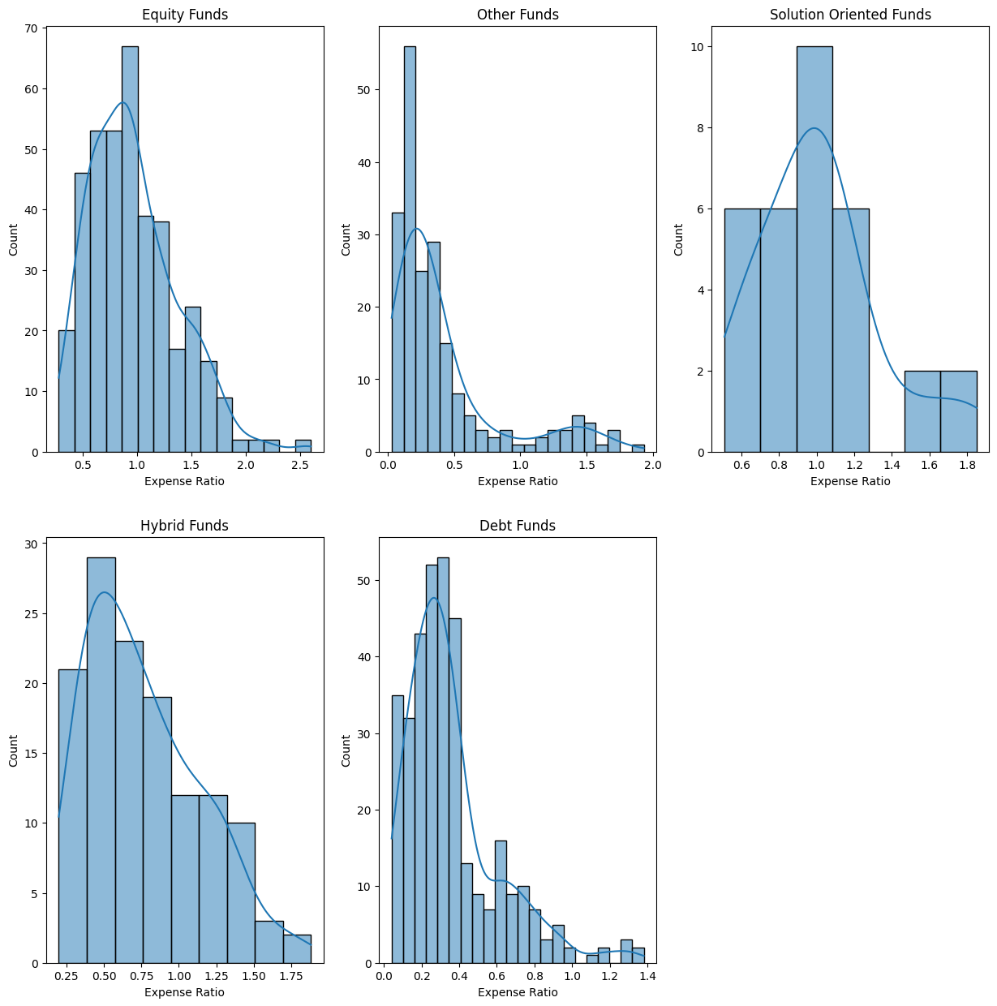
Analyse Expense Ratio based on Funds Type
In Equity Fund most Funds Expense Ratios are Distribute around 0.5% to 1%.
In Other Mutual Funds many Funds are available below 0.5%.
Debt Funds have more number of funds with very less expense ratio when compare with other types.
Solution Oriented Funds have slightly higher Expense Ratio compare with other types.

Slide 27
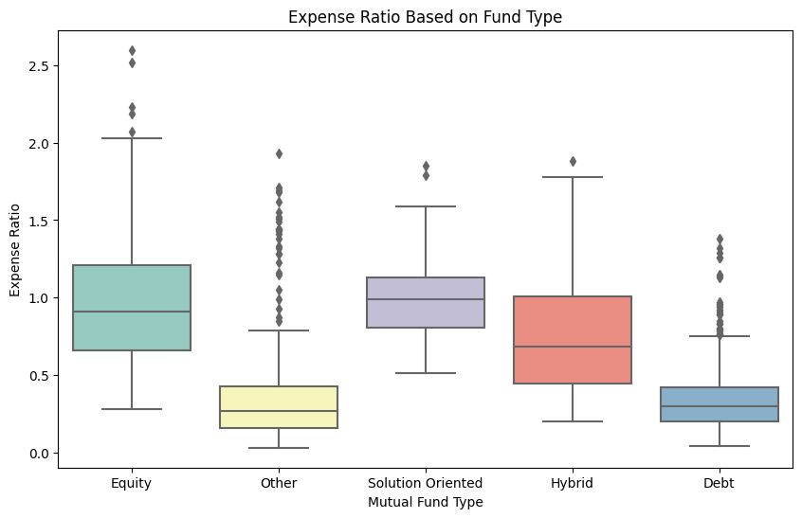
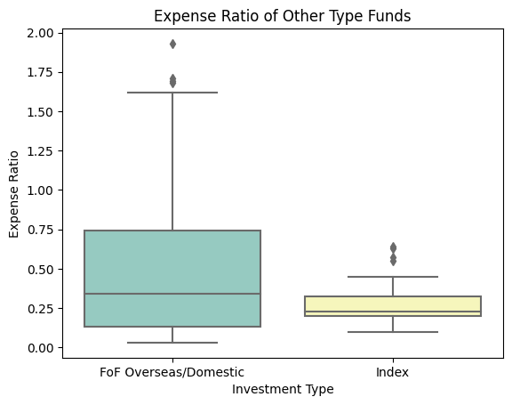
Expense Ratio based on Funds Type
Other and Debt funds have less expense Ratios.
Solution Oriented Fund’s minimum expense ratio was higher than other funds minimum.
Other Funds have more outliers. Due to the Overseas FOF have high Expense Ratios than domestic FOF and Index funds.

Slide 28
Expense Ratio Conclusion
By this Expense Ratio Analysis it is better to avoid Solution Oriented Funds
In Other Funds, Index Funds have very less Expense Ratio as like Debt Funds
To Design a well diversified Mutual fund Portfolio include Debt and Index fund to reduce cumulative Expense Ratio

Slide 29
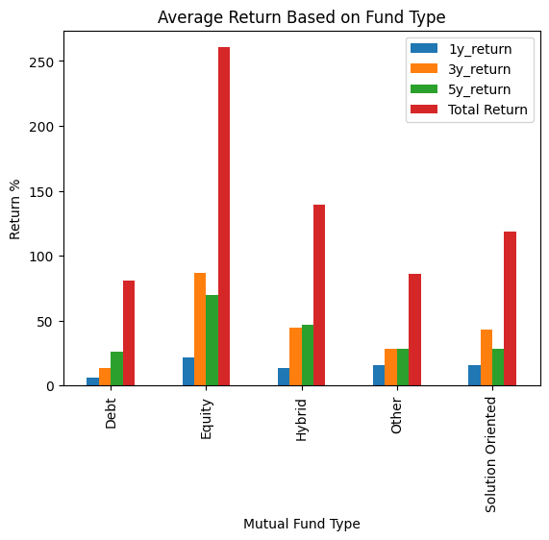
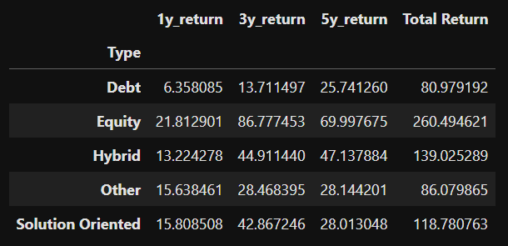
Average Return based on Funds Type
Equity Fund generates High Return when compared with other type of funds.
Debt Fund risk is very low corresponding to that return also low.
Solution Oriented Funds and Hybrid Funds are having high expense Ratio so if their return are good also we can avoid it.
Other Funds return was considerable and Expense Ratio was very low.

Slide 30
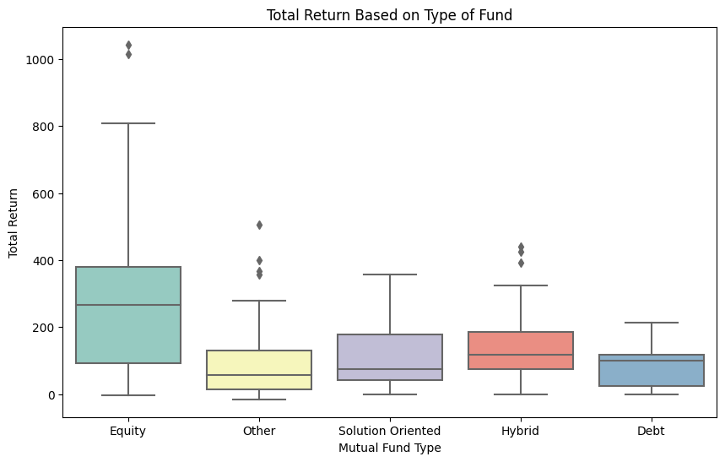
Return based on Funds Type
Changes of getting higher returns for long term is possible in Equity funds.
If we choose Solution oriented or Debt funds then change of getting unexpected return is minimum.
Sometimes unexceptional Returns are possible in Hybrid, Other and Equity Funds

Slide 31
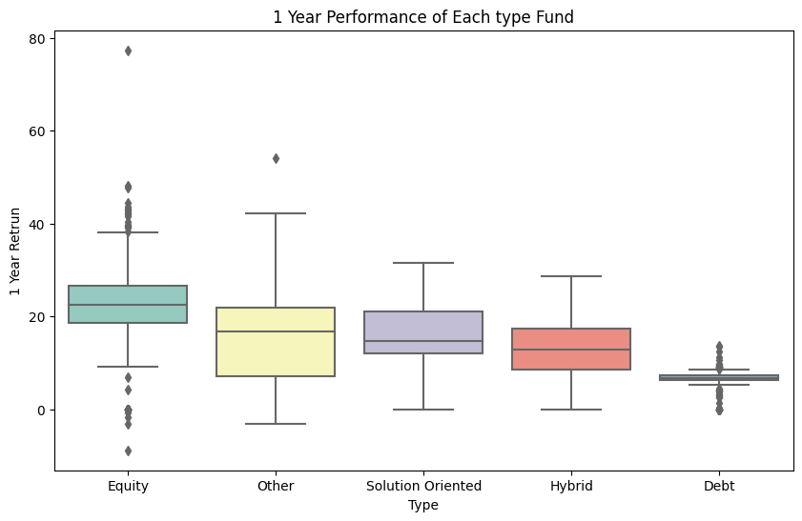
1 Year Return based on Funds Type
If we invest in Equity Fund for 1 year chance of getting negative return is also possible.
Other fund perform better than all type of funds.
Debt fund perform very less so that the range is not clearly visible in this plot

Slide 32
Expense Ratio and Return Conclusion
Return and Expense Ratio not seems extraordinary in Solution Oriented Funds
Index Funds have very less Expense Ratio and Returns also decent. So we can consider index fund in our portfolio.
Equity Funds gives high Return so that we select Fund which have medium Expense Radio and High Return.
In Debt Funds Expense Ratio and Return both are less

Slide 33
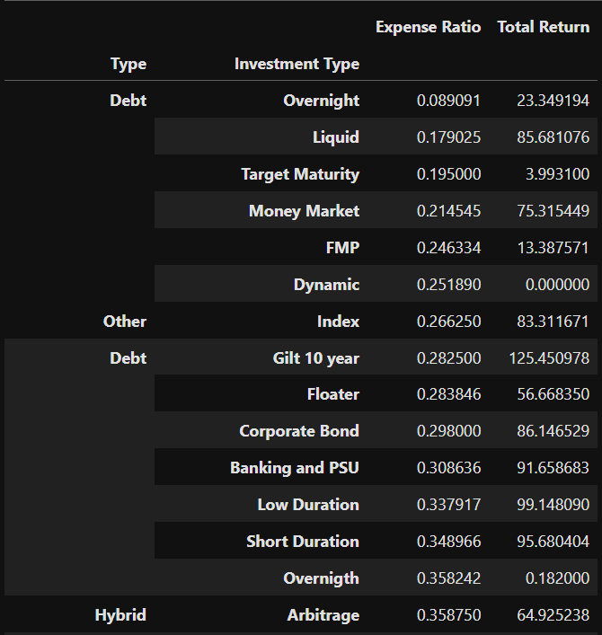
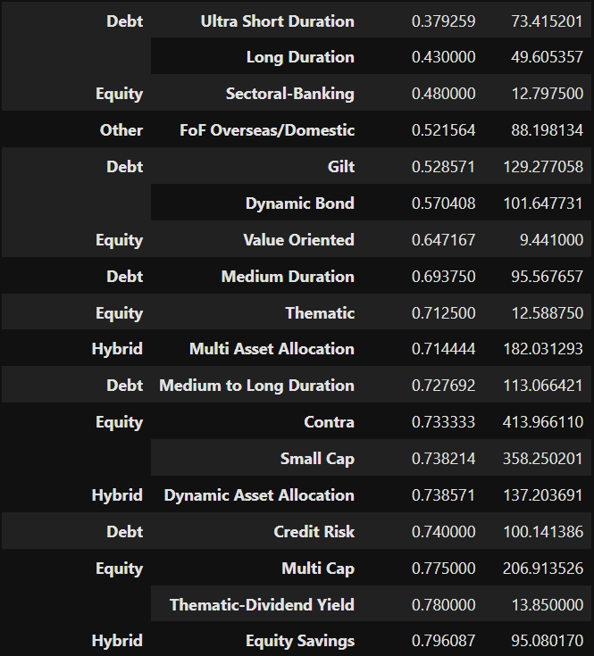
Average Expense Ratio and Return

Slide 34
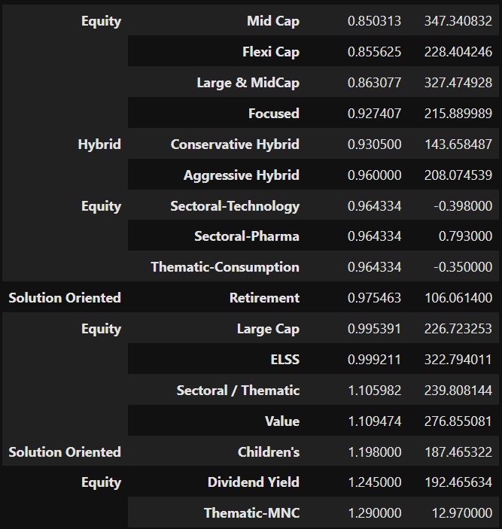
Average Expense Ratio and Return
Index Funds have very less Average Expense Ratio
Equity Fund Contra and Small Cap funds have high Average Return
Majority of Debt fund have less Average Expense Ratio

Slide 35
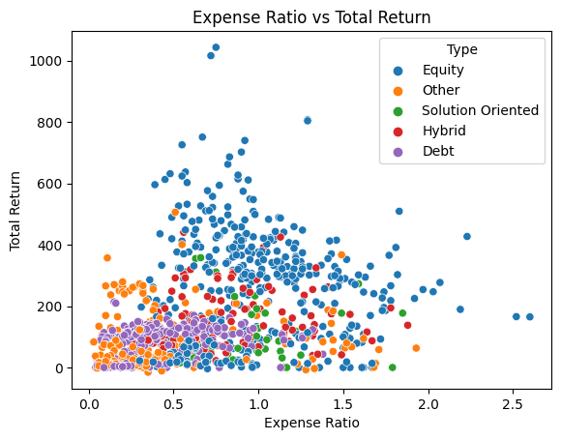
Did High Expense Ratio give High Returns?

Slide 36
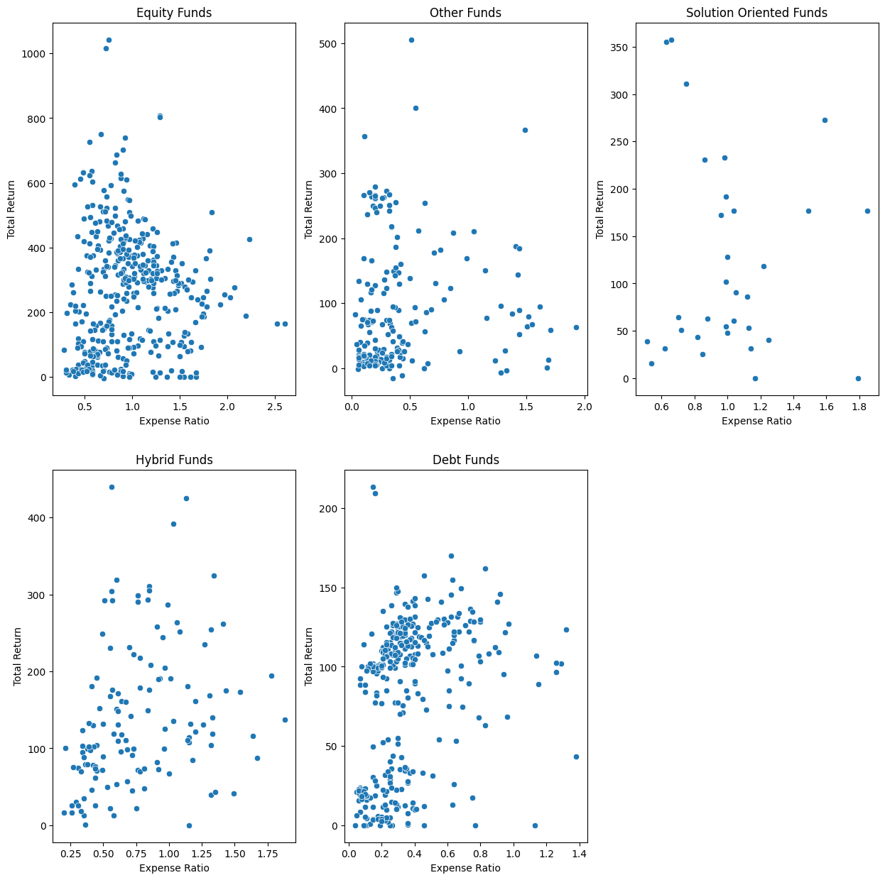
Did High Expense Ratio give High Returns?

Slide 37
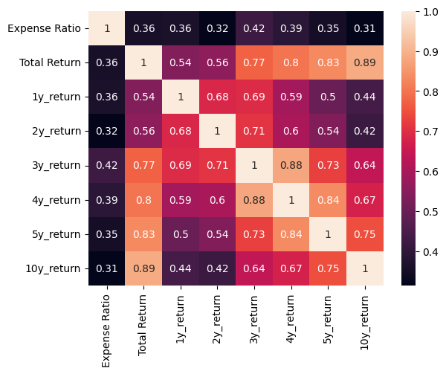
Did High Expense Ratio give High Returns?

Slide 38
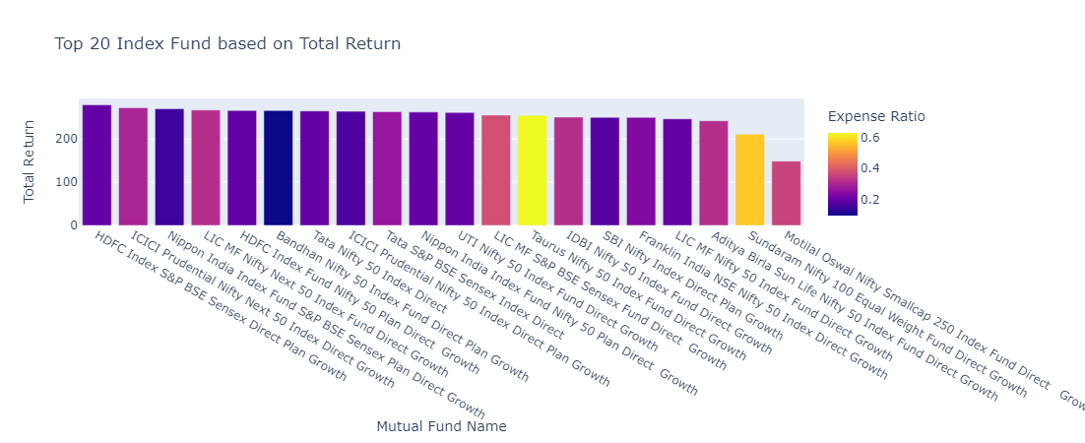
Select Index Fund Based on Performance

Slide 39
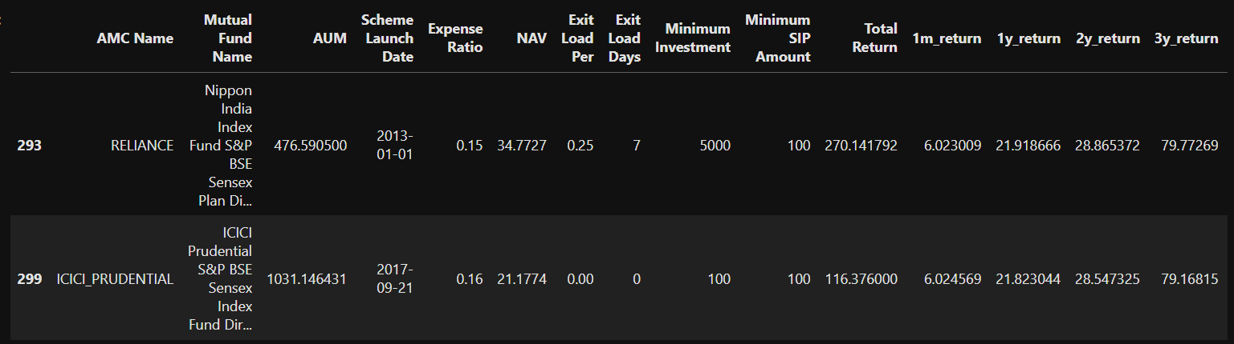
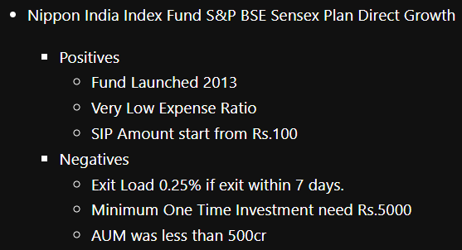
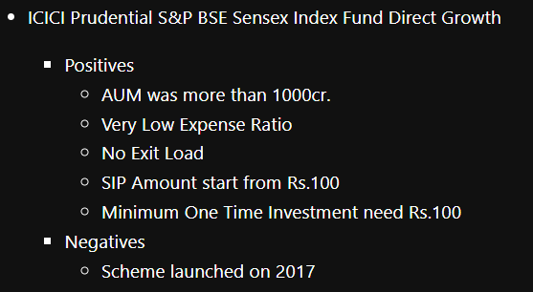
Index Fund Recommendation

Slide 40
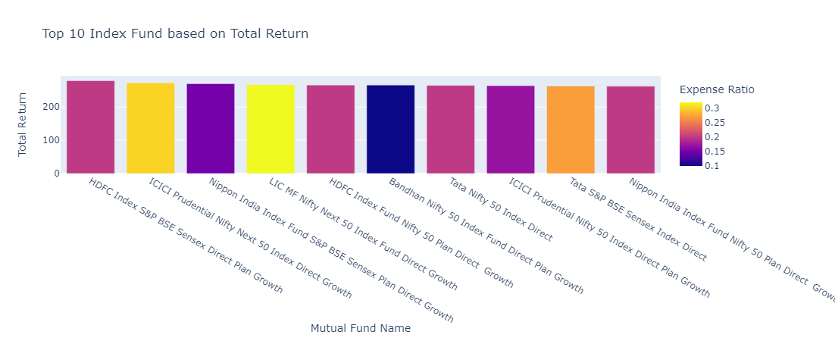
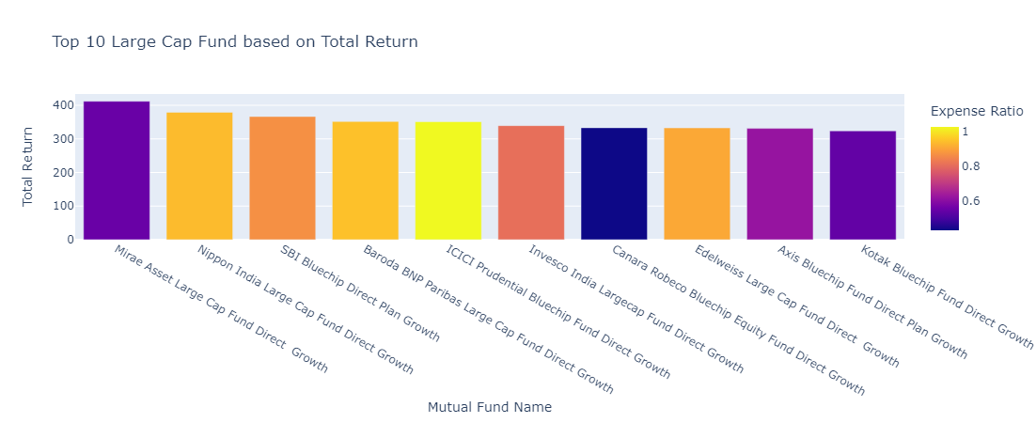
Index Funds vs Large Cap Funds

Slide 41
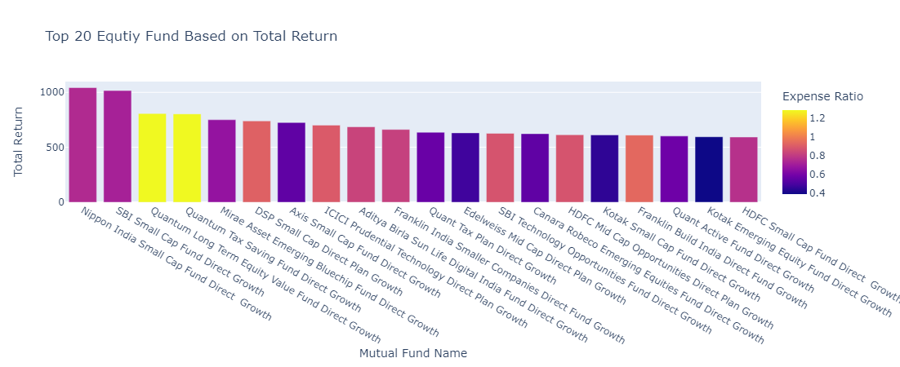
Select Equity Fund Based on Performance

Slide 42
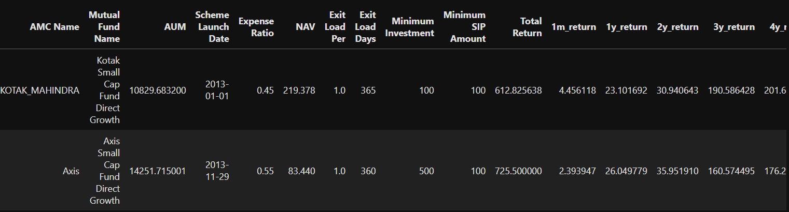
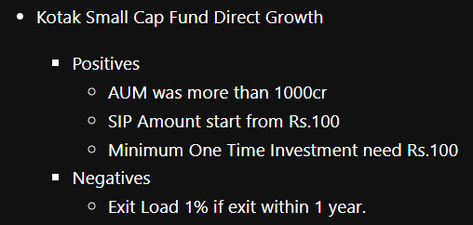
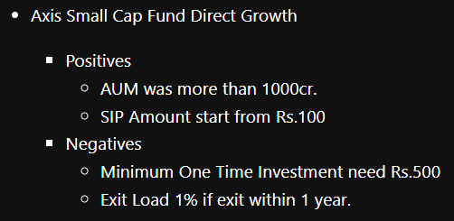
Equity Fund Recommendation

Slide 43
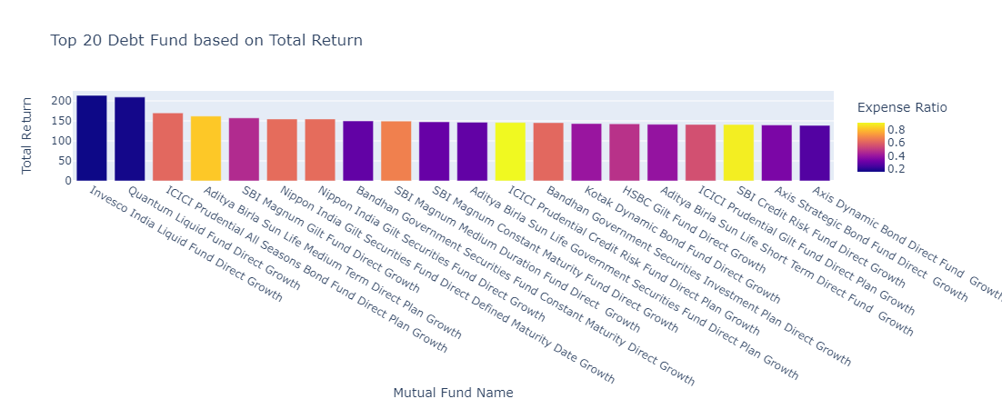
Select Debt Fund Based on Performance

Slide 44




Debt Fund Recommendation

Slide 45
Final Mutual Fund Portfolio
ICICI Prudential S&P BSE Sensex Index Fund Direct Growth
Kotak Small Cap Fund
Invesco India Liquid Fund
Disclaimer:
Mutual funds are subjected to market risks. Please read all the scheme related documents carefully before Investing.
we are not a SEBI Registered Advisors, and this is not an investment advice this analysis conducted for study purpose only if you are going to invest in mutual funds consult your personal financial advice and do it on your own Risk.

Slide 46
Any Questions

Slide 47

THANK YOU

